Slide 2
Chapter 2
Factors that Affect Cloud Computing

Slide 3
Learning Outcomes
At the end of the session you will be able to:
Understand cloud data center requirements
Describe architectural, technological, and operational influences on cloud
computing
Enlist issues in scalability of cloud architecture and applications
Understand influences of cloud on various businesses
Define autonomic computing
Explain IT service management

Slide 4
Introduction
Cloud computing is a technology which utilizes the Internet and central isolated servers in order to sustain applications and data.
This technology permits much more proficient computing by consolidating bandwidth, processing, and storage memory.
Cloud offers robust memory administration, thus there is no necessity to sustain memory on a personal system.

Slide 5
Cloud Data Center Requirements
A data center comprises the following areas:
The first distribution area consists of various network equipment such as switches, routers, multiplexers, and firewalls.
The second distribution area consists of network, storage, etc.
The third area is that place where the actual rack cabinet is kept for computing and storage.

Slide 6
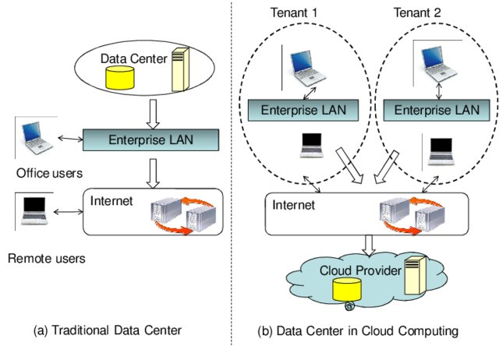
Traditional Data Center Vs Cloud Data Center

Slide 7
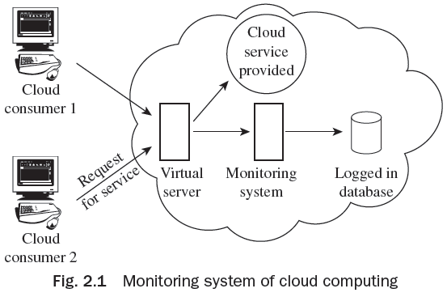
Architectural Influences of Cloud Computing
Cloud computing has been backed by architectural growth. They are:
High-performance Computing
Utility and Enterprise Grid Computing
Autonomic Computing
Server Consolidation
Horizontal Scaling
Web Services
High-scalability Architecture

Slide 8
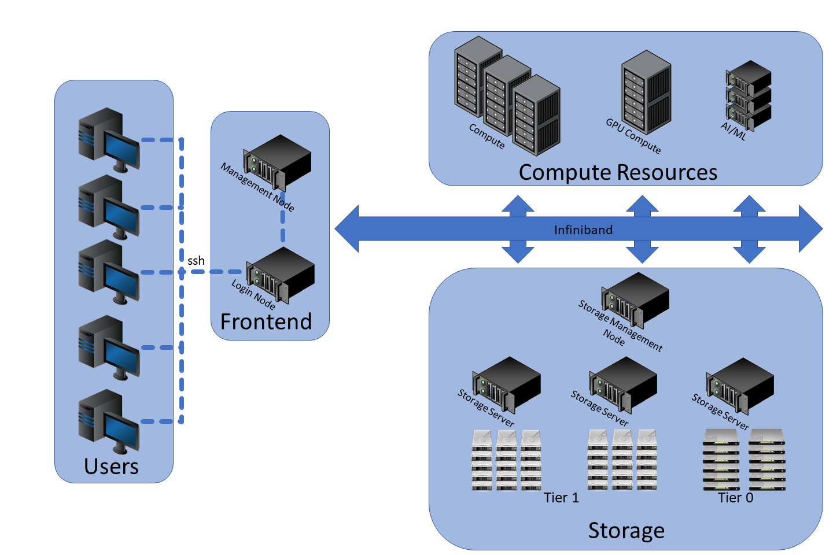
HPC

Slide 9
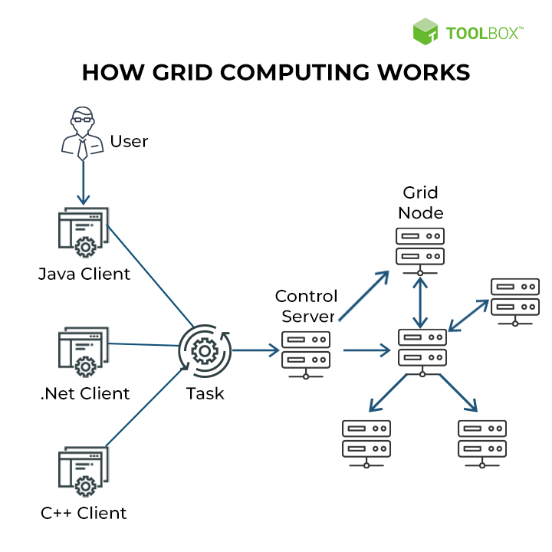
Grid Computing

Slide 10
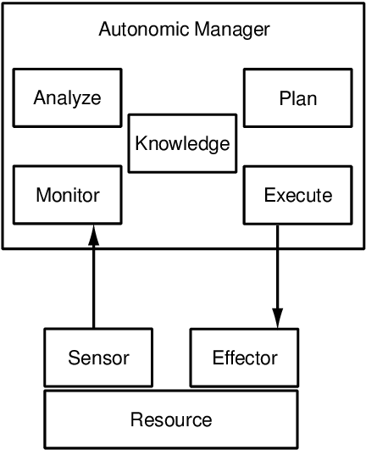
Autonomic Computing
Autonomic Computing is a vision initiated by IBM in 2001 to build a large scale distributed system without any human interaction.
It was developed to beat the complications of computer systems management and improve self- management for the computer systems.

Slide 11
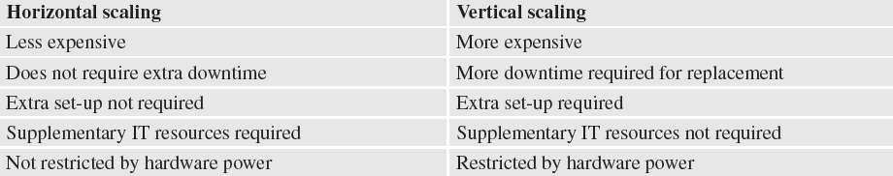
Horizontal and Vertical Scaling
Differences between horizontal scaling and vertical scaling:

Slide 12
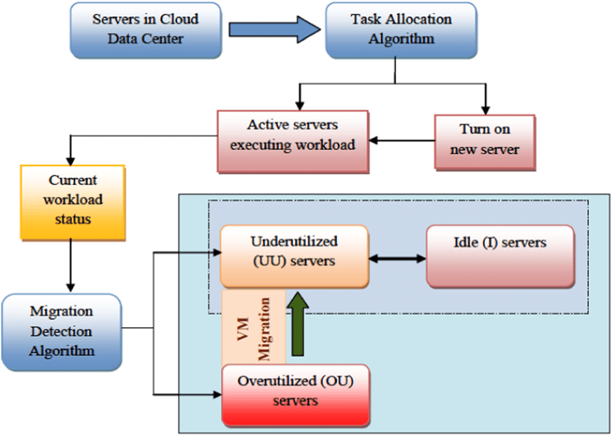
Server Consolidation
Server consolidation is the process of migrating network services and applications from multiple computers to a singular computer. This consolidation can include multiple physical computers to multiple virtual computers on one host computer.

Slide 13
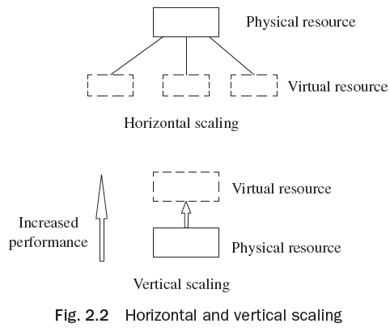
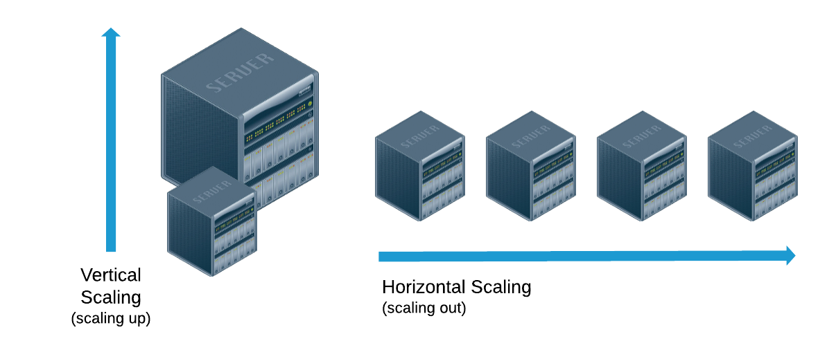
Horizontal and Vertical Scaling
Cassandra, MongoDB, Google Cloud Spanner
MySQL, Amazon RDS

Slide 14
Challenges faced by an Application Developer in Developing Cloud Applications
Lack of standardization
Lack of extra programming support
Debugging and development kits
Metrics and best practices

Slide 15
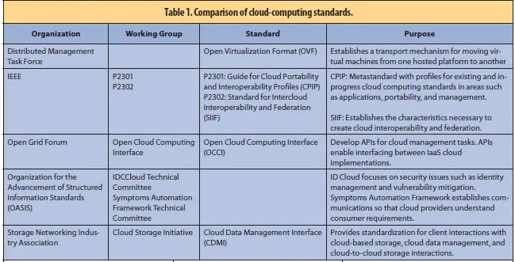
Cloud computing standards

Slide 16
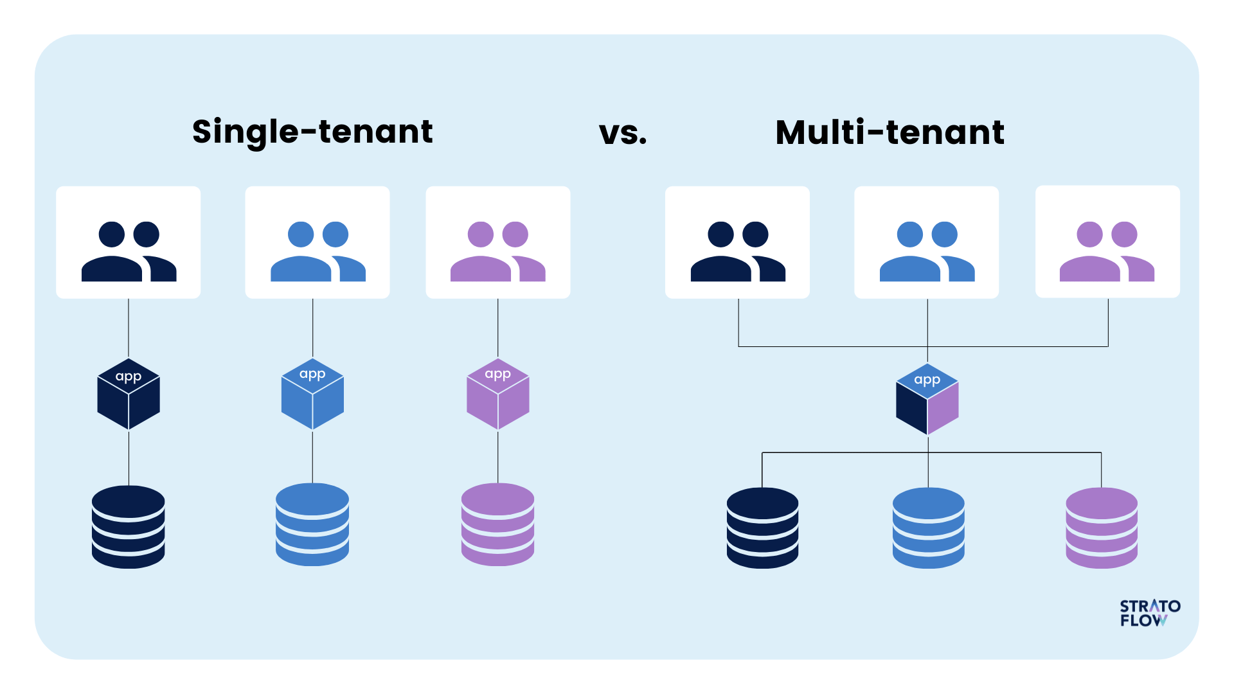
Design Patterns for Key Issues of Cloud Application Development
The design patterns include:
Scalability
Availability
Multi-Tenacity
High Performance
Rapid Elasticity

Slide 17
Technological Influences of Cloud Computing
Universal Connectivity
Commoditization
Open-source Software
Virtualization

Slide 18
Operational Influences of Cloud Computing
Consolidation
Outsourcing
Information Technology Service Management
Automation

Slide 19
Influence of Cloud Computing on Business Companies
Cloud computing with various advantages and tools affect many companies’
working style and is discussed in detail in the following parameters:
Business Alignment
Governance

Slide 20
Influence of Cloud Computing on Business Companies
Business Alignment
A business alliance of all IT self-service applications, particularly console applications and enterprise intelligence, is vital for sustaining information quality, and is significant in the modern world of IT self service. The concentration of the IT team of a corporation transfers from running hardware assets and data center functions to handling the following responsibilities:
1.Recognizing enterprise policies, functioning metrics, drivers, market
dynamics, purposes, and many more
2.Classifying trade definitions (business unit, department-level, etc.) and trade
regulations

Slide 21
Influence of Cloud Computing on Business Companies
3. Forming a value-added information collection which links to the purposes
and aims of a corporation
4. Assessing and predicting the realistic advantage of cloud computing
applications
5. Recognizing modern challenges of risk administration in on-demand IT self-
service

Slide 22
Influence of Cloud Computing on Business Companies
Governance
The following points are important to know how cloud computing affects control and governance on data stored, when you are a cloud user:
Process controls and process observation
Content secrecy and safety
Content consistency and master data management
Cloud computing capability maturity model (CMM)
Incorporating and running rising cloud computing IT models—SaaS, IaaS, and PaaS

Slide 23
Influence of Cloud Computing on Business Companies
The cloud maturity module comprises 60 abilities which encapsulate the finest practices. Such abilities offer the feature mandatory to actually assess and direct the development of cloud proposals. There are six spheres in the maturity model:
Business and strategy
Architecture
Infrastructure
Information
Projects, portfolios, and services
Operations, administration, and management

Slide 24

Video

Slide 25
Thank You!

